Slide 1
OVC All Hands
Meeting
March 18, 2019

Slide 2
Agenda
Brief Update on OVC Ian A. Waitz, Vice Chancellor for Undergraduate and Graduate Education
"Exploring the Registrar's Office" Mary Callahan, Registrar & Senior Associate Dean Brian Canavan, Sr. Associate Registrar Kathleen MacArthur, Associate Dean for Curriculum & Faculty
Refreshments
OVC All Hands | Slide 2

Slide 3
OVC
Realign
Refine
Localize
Amazing progress in 18-months
April 2017
DUE+ODGE come together
July 2017 - March 2018
Defining models for the future organization
March 2018 - Jan 2019
Living in the new org and adjusting
Jan 2019 -Present
Office-based strategies
OVC All Hands | Slide 3
Notes:
We have made incredible strides in terms of building the new OVC organization in the past 18 months. In a relatively short span of time, DUE and ODGE have come together; we have realigned some reporting structures; we are implementing those structures. We have done this all while carrying out our core functions with a commitment to excellence.
A natural next step in this progress is to think about local strategies to help sustain our focus and commitment to our work and to attend to our individual wellness.
It’s a balancing act…

Slide 4
Finding balance
Embed ongoing prioritization into the OVC culture
Create space for people to breathe, achieve better work-life integration and attend to wellness
Free up capacity to focus on strategic priorities
Identify ways to streamline processes
We have 40+ priorities
We respond to daily needs and challenges at work and at home
It can sometimes feel overwhelming
OVC All Hands | Slide 4
Notes:
Image: James Tanabe ’00, ’01.After studying earth, atmospheric, and planetary sciences and physics at MIT (while also learning stunt coordination and professional dance on the side), Tanabe pursued his ultimate dream—joining the circus.
Students, faculty and senior leadership call on us to carry out an aggressive workload on behalf of the community. That can feel exhilarating, but also overwhelming at times.
A strategy that will help us to maintain some semblance of balance is to be very clear about what our priorities are at the local level. At the Office Heads retreat, we talked about engaging staff broadly and repeatedly in conversation about priority setting.
A number of OVC offices already have processes to do this.
Priority setting is a natural continuation of the work that dates back to the formation of OVC (creating the right organization, defining values and strategic priorities, and embracing experimentation and innovation).
This work is meant to make “more room” to do new and innovative things while ensuring crucial activities are still done with excellence.
While smart budgeting is always a motivator, the primary driver is working smarter and working better and creating more work-life integration.
This work will have some natural integration with cross-functional teams (existing or future).
This work is ongoing and is in response to the reality that our students, pedagogy, and institution continue to change and evolve (like the College of Computing) and allows us to prepare for the work ahead.
We want to move from the dominant narrative of “I feel overwhelmed” to “I’m really excited that I am working on x …” and more celebration of little victories.
Offices are leading local efforts and doing it at their own pace.
Offices level work is crucial … and some offices are already well under way, others are just starting.

Slide 5
Where we want to go
Everyone feels that their work is important and valued.
Everyone understands the bigger picture and how their work fits with their local office and/or OVC mission.
Everyone feels prepared for the work ahead—knowing that our students, pedagogy, and institution continue to change and evolve.
Everyone takes time out to celebrate victories (big and small).
Shameless plug: Appreciation and Infinite Mile Programs!
OVC All Hands | Slide 5
Notes:
I am hoping that by being crystal clear about our priorities will lead to ….
Everyone is doing important work and contributing to the mission
This might be through a cross-functional team, by focusing on the strategic priorities, or in other ways
Everyone understands the bigger picture and how their work fits with office or OVC strategy
and has ways for them to contribute broadly as interest time allows.
Everyone takes time out to celebrate victories (big and small)
There is a lot of great work happening across OVC!
So before I turn it over to Mary Callahan, let me take a few minutes to celebrate work that is being done and to update you on 3 key priorities

Slide 6
Working together
Cross functional teams help share some of the load
Grad Family Support Working Group (just kicked off)
Wellness Committee (seeking members!)
Careers Exploration (report due)
Student Prof Development Working Group (report due)
International Students of Color Onboarding (making progress)
And many others underway…
OVC All Hands | Slide 6
Notes:
Efforts improved by bringing together diverse groups from across OVC with different perspectives and expertise

Slide 7
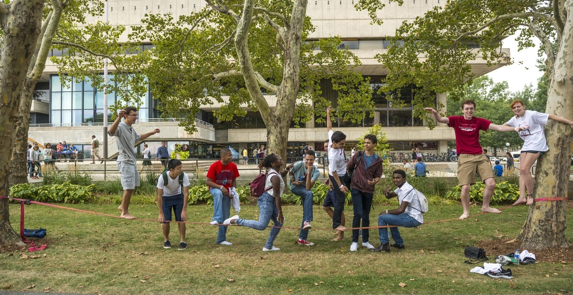
Created
OFY
Enhanced orientation
DFY and CUP pilots
Transform the first year
undergraduate experience
OVC All Hands | Slide 7
Notes:
Creation of the Office of the First Year (OFY)
Ian decided to be the interim Director of OFY given his deep involvement in re-engineering the First Year
Enhanced first-year orientation programming
Content focused on encouraging exploration
Improved advisor training
"Designing the First Year at MIT" class led to …
CUP pilot (flexible GIRs) for class of 2022 (from June – August)
Sponsorship of more exploratory courses
All done in close collaboration with OFY, Registrar's Office, TLL, and school and departmental leaders

Slide 8
What's next
Potential experiment for the Class of 2023 in discussion with CUP
Advising pilot for the Class of 2023
FirstGen FPOP
Testing “blue-sky ideas” in first-year learning communities
OVC All Hands | Slide 8
Notes:
Also note: Emily Pons has first-gen stickers!

Slide 9
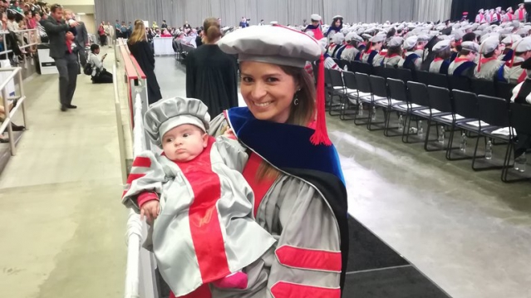
Advising efforts
Professional development
Support and Wellness
Become a leader in advising and professional development of graduate students
OVC All Hands | Slide 9
Notes:
Update on priority #2: Become a leader in advising and professional development of graduate students
Advising Efforts
DSP climate and culture initiative via MindHandHeart
IR grad advising meta-analysis
Faculty advising philosophy statements pilot with GradSAGE (School of Engineering)
Professional Development
Drafted student professional development core competencies
Burroughs Welcome Fund proposal for prof development in the School of Science
Rollout of the MITAA Advisor’s Hub (undergraduate as well)
Support and Wellness
New FTE for GPS
MHH DSP efforts
Continued collaboration with GradSAGE (School of Engineering) + other schools / departments
Grad Families working group

Slide 10
What's next
Student professional development framework roll out from CAPD
Individual Development Plan (IDP) pilot
TLL led faculty advising cohort pilot
Create a week of Graduate Professional Development
New staff member to Graduate Personal Support
Building networks with departments
OVC All Hands | Slide 10
Notes:
Addition of new staff member to Graduate Personal Support
Building network with departments
Creating training for graduate students

Slide 11
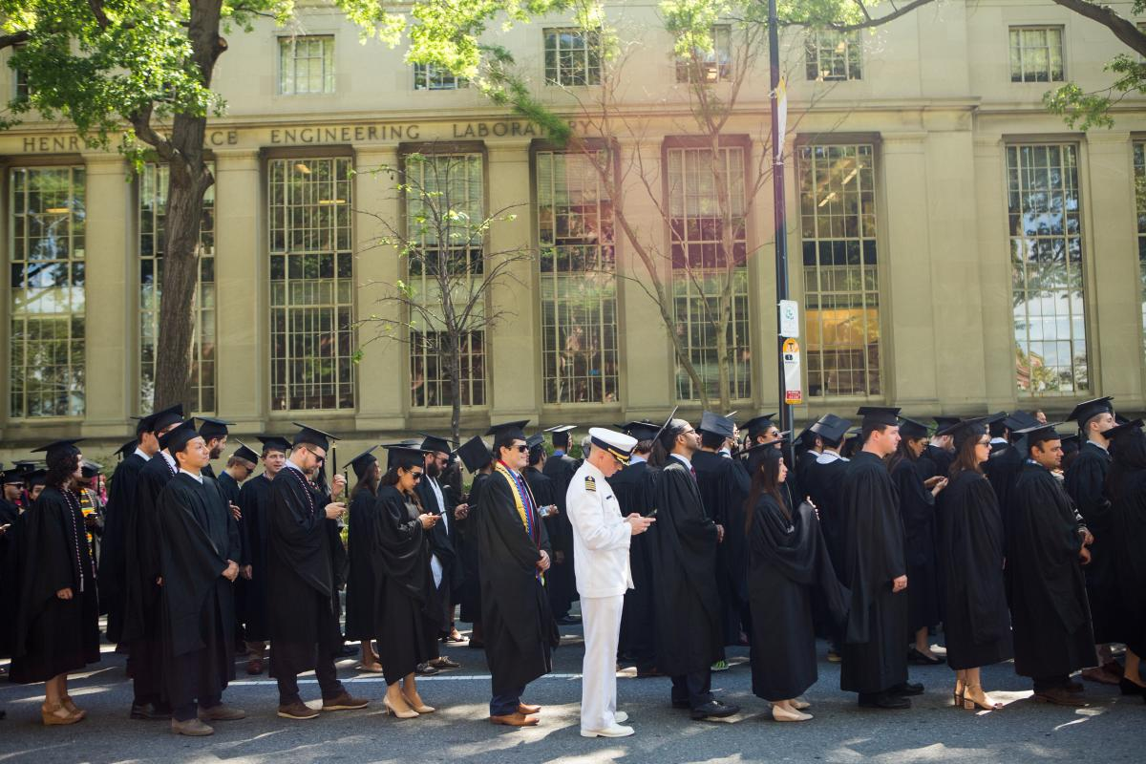
Cross functional teams
OGE systems enhancements
Office-based efforts
Lead and manage OVC to provide enhanced services and programs for students & faculty
OVC All Hands | Slide 11
Notes:
Cross-functional teams
Graduate Family Support Working Group
Wellness Committee
Data coordination
Designing the First Year at MIT
Graduate Housing (with DSL, GSC)
Career Explorations
Student Professional Development Working Group
International Students of Color Onboarding
with others to come …
OGE systems enhancement
OGE in partnership with MIT IS&T has launched a student to determine Scope, Time and Cost to modernize the following processes:
Visitor Management System to identify the number of visitors to OGE and purpose of visit
Student Funding Request System-OGE administers funding for several programs. The goal is to perform this process on online.
MIT Graduate Student Childbirth Accommodation and Parental Leave Request – goal is to move this process off paper to online.
Enhancement of Office 365 for OGE staff to work more efficiently including the option of students to book appointments online.
Office-based efforts
Launched an office-based (including HQ) comprehensive work prioritization evaluation
Have already identified some programs to stop doing such as the Amgen Scholars Program which was labor intensive but didn’t advance strategic goals.
Conducted an inventory of all OVC UG & G diversity and inclusion programs including annual programs cost, cost per participant and assessment (quantitative or qualitative) of program outcomes.
Conducting rigorous annual budgeting exercises bolstered by data

Slide 12
What's on my mind
Spring weather!
Meeting and welcoming the new undergraduate class of 2023 and incoming graduate students
OVC All Hands | Slide 12

Slide 13
And finally… our Excellence Award Winners
Serving the Client
Donyatta Small, Interim Director of Administrative Computing, OVC
Bringing out the Best
International Students Office Team Maria Brennan, Associate Director, International Students Office
Cedrick Boursiquot, SEVIS Systems Coordinator & Data Analyst
Antoinette Browne, Operations Associate
Aurora Brulé, International Students Advisor
Emily A. Cheng, Assistant Director for Operations & Advising
Carlene Green-Paul, Admissions & Advising Associate
Sylvia Hiestand, Assistant Director for Advising Outreach
Janka Moss, International Students Advisor
Dana Riechman, International Student Programming Administrator & Advisor
Jacqueline Souza, Administrative Assistant/ Designated Student Officer
Mayoka Takemori, Manager of Visiting Student Program
Megumi Wang, International Students Advisor
OVC All Hands | Slide 13
Notes:
Emily has stickers!

Slide 14
Notes:
My thanks to all of you and your hard work.
And for doing it with integrity … and heart.
Now let me turn it over to Mary Callahan so we can learn more about the Registrar’s Office similar to the way we learned about PKG last summer.
I would also like to recognize all of the Registrar's staff for the work on changing commencement timing and CUP and give a big shout out for the success of last week's Macvicar symposium!

